Slide 2
Building RAG Applications
with Azure OpenAI
&
Azure AI Search
Prateek Singh

Slide 3

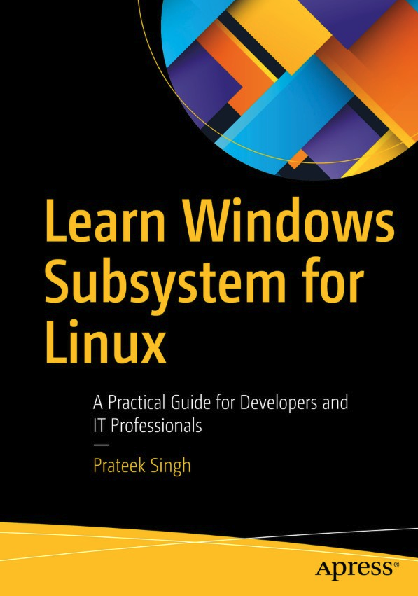

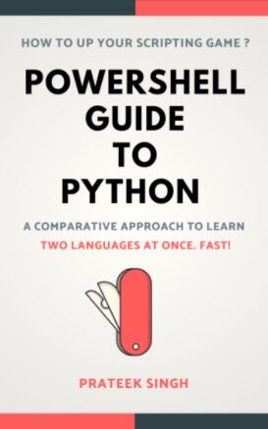
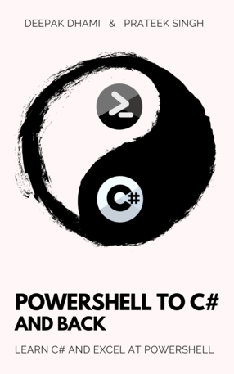


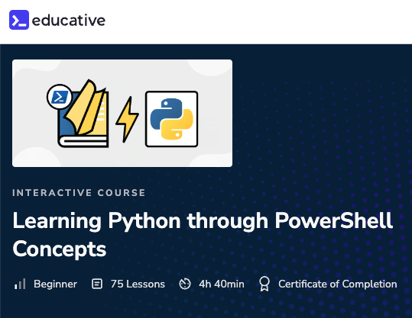



Books
Prateek Singh
Founder @ ganak.ai
Ex-Staff SWE Linkedin
Course
Articles

Slide 4
Agenda
LLM and its Limitations
Why RAG?
RAG Primer
DEMO 1 - Basic Vector Search
Preparing your data
Chunking data
Embeddings & Vectors
Indexing
Retrieval of Data
Semantic Similarity
Generation (Grounding)
Limitations and next steps
Azure AI Search & Azure Foundry
DEMO 2 - Building a RAG Web Application
Azure AI Search - Data, Indexes and Retrieval
Creating a web app using AI Foundry
Takeaways

Slide 5
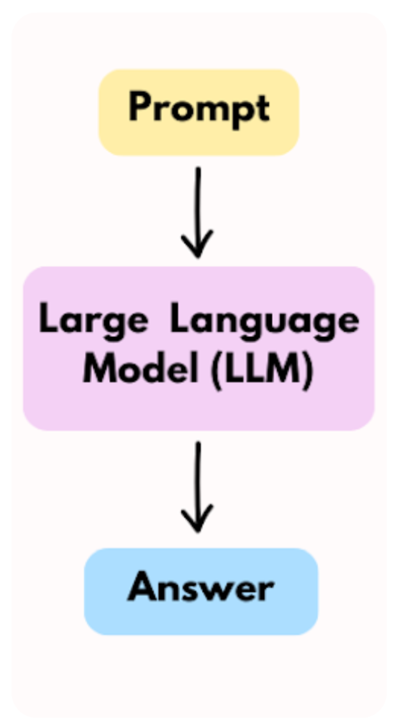
LLMs and Its Limitations
THE GOOD PARTS
Generate fluent, human-like text
Answer questions from learned patterns
Handle large context windows (up to 100k tokens) in latest models (eg. LLaMA 3)
LIMITATIONS
Static knowledge LLMs don’t know new facts or updates after training cutoff
Increased context = increased cost and latency Sending large prompts every time is expensive and slow
No inherent retrieval mechanism LLMs don’t “search” a database—they predict text from patterns
Context window* ≠ infinite knowledge Even 100k tokens isn’t enough to encode all your data, documents, or enterprise knowledge
Hallucinations remain Models can confidently generate incorrect or fabricated information
Fine-tuning is slow and costly Updating LLMs with proprietary data requires resource-intensive fine-tuning

Slide 6
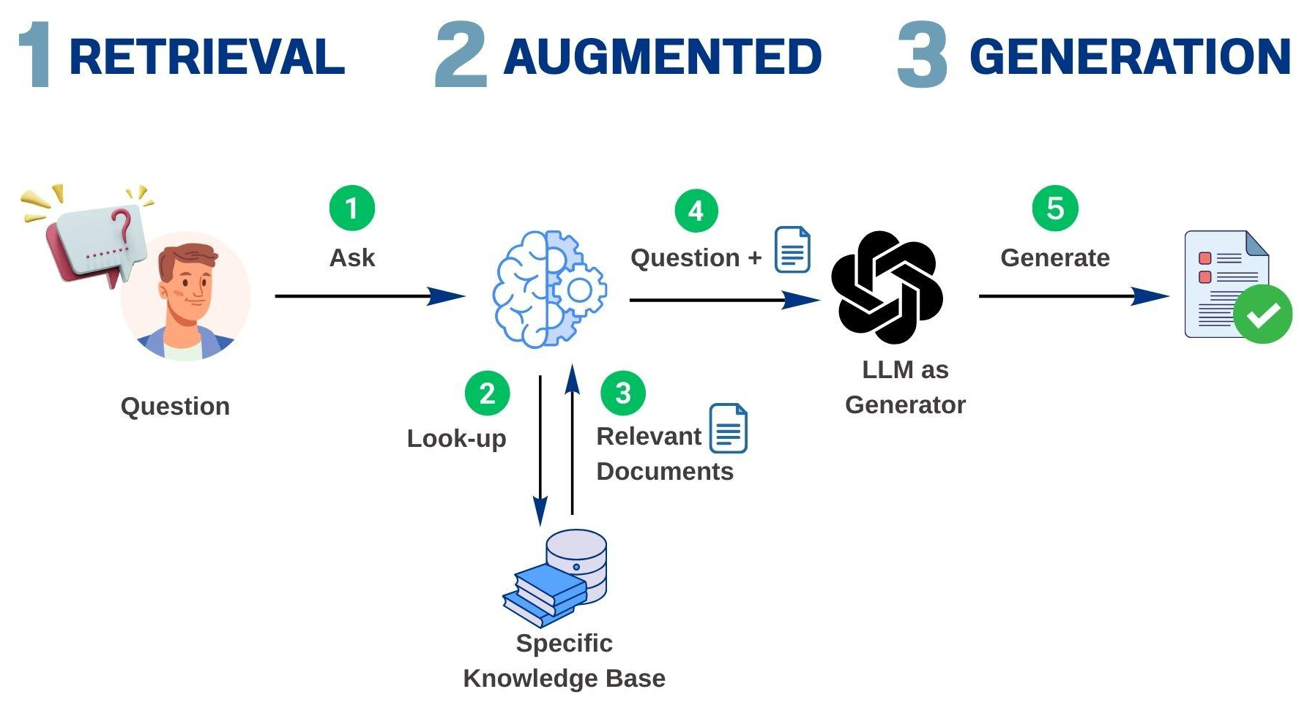
What is Retrieval Augmented Generation (RAG)?
Enhances Large Language Models (LLMs) with external knowledge retrieval
References authoritative, up-to-date data before generating answers
Eliminates the need for costly retraining of the LLM
Improves accuracy, relevance, and domain-specificity
Keeps responses grounded in trusted sources
Cost-effective way to extend LLMs for real-world use cases

Slide 7
What this means?
" LLMs are incredibly powerful . No Doubt about it.
But they can’t know what they haven’t been trained on.
RAG brings the missing piece: connecting the LLM to your own data at query time, without retraining.
It makes answers both relevant and grounded in Facts. "

Slide 8
DEMO-1
Basic Vector Search

Slide 9
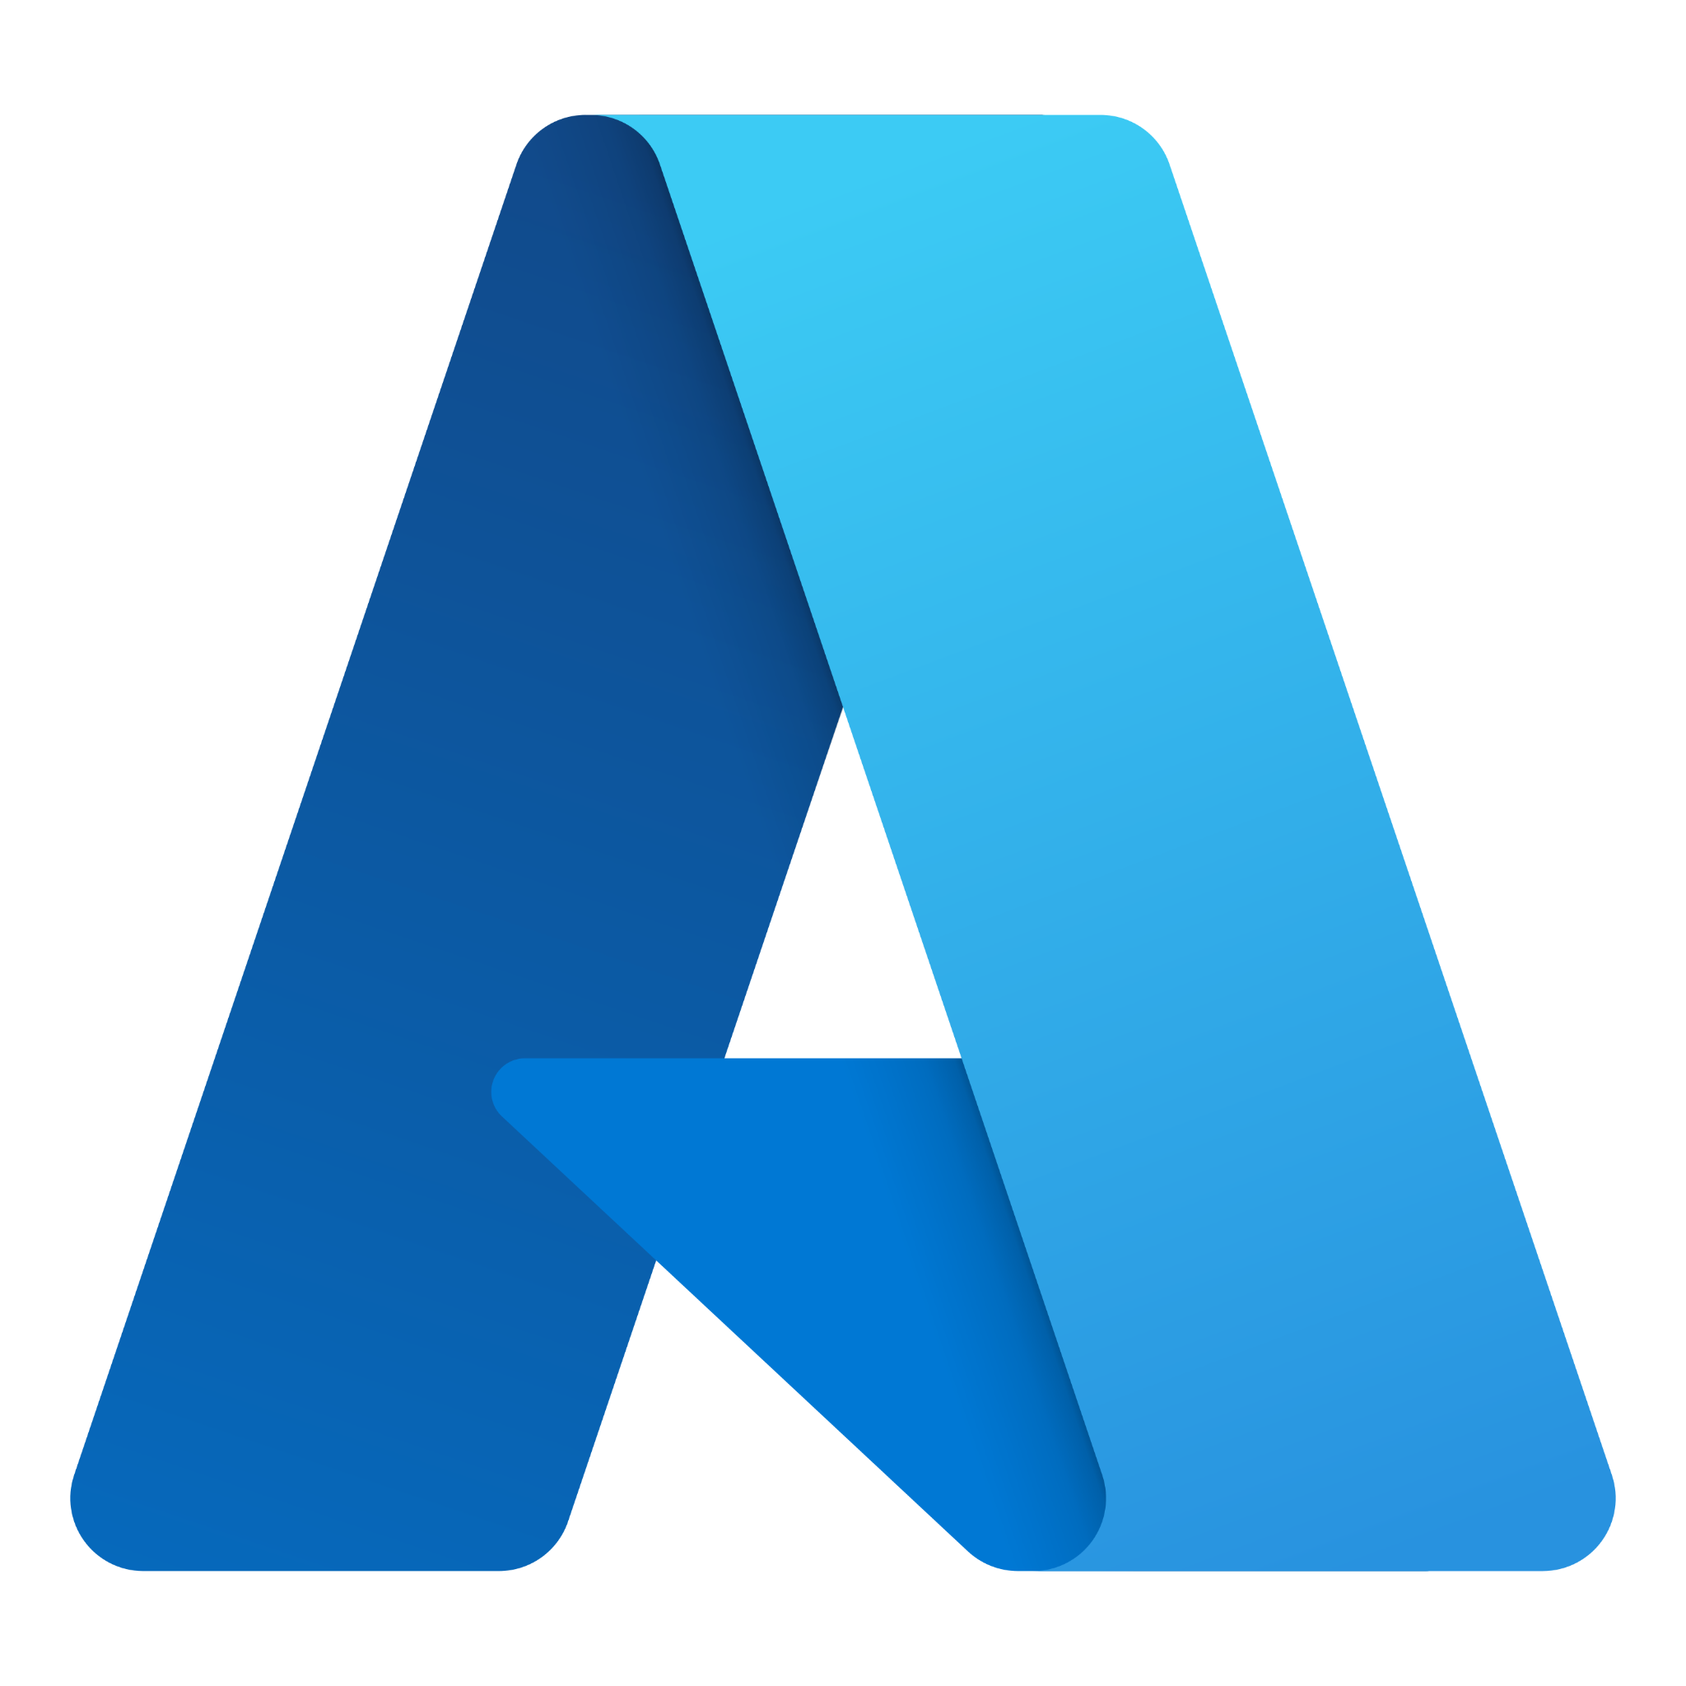

Azure AI Search
Overview
Enterprise-ready search platform for structured and unstructured data
Ingests heterogeneous content into a unified search index
Powers search-driven apps and queries at high scale and performance
Key Capabilities
Built-in advanced search technologies: full-text search, filtering, faceting, scoring
Native integrations with Azure OpenAI Service and Azure Machine Learning
Flexible for both traditional and generative AI (GenAI) search scenarios
Why Use Azure AI Search for RAG?
Recommended retrieval system for RAG apps on Azure
Supports relevance tuning, vector search, hybrid search out of the box
Enables seamless integration with LLMs for grounding responses
Ideal for catalog search, information discovery, and conversational AI

Slide 10
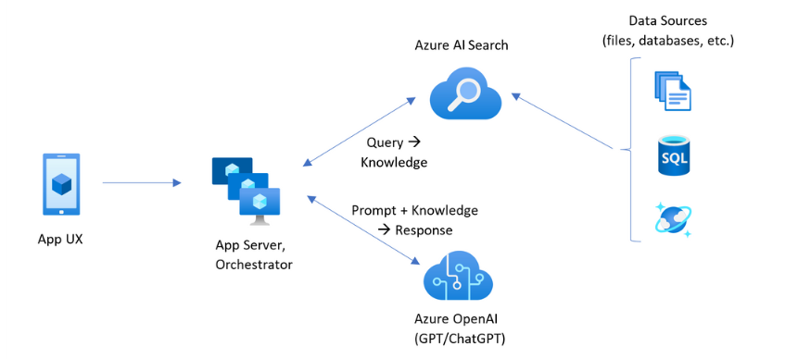
Azure AI Search

Slide 11
DEMO-2
Building a RAG
Web Application
with Azure AI Search

Slide 12
References
MSFT Documentation - Azure AI Search RAG
Azure AI Foundry - ai.azure.com
This Slide deck & code samples - bit.ly/prateektalks

Slide 13
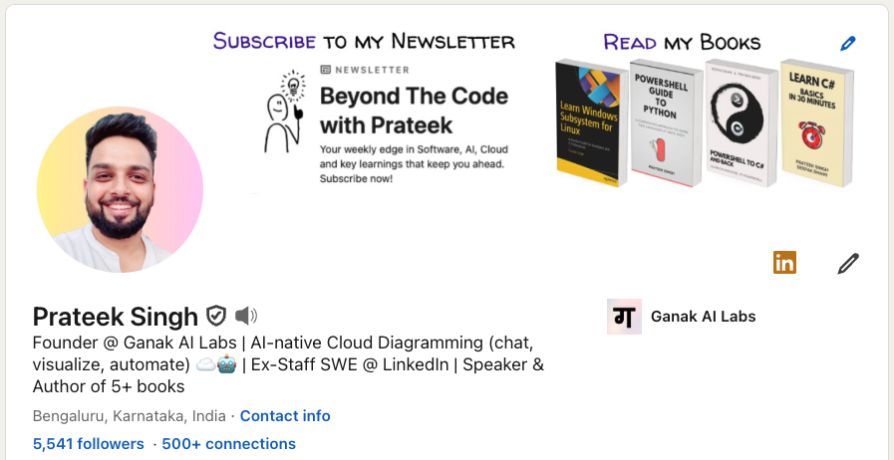

Lets Connect!
Connect with me on LinkedIn I share insights on AI, Cloud, and Software Engineering.

